Slide 1
For Live Session
Unit 12

Slide 2
Activity One: Check Out These GitHub Pages (30 min)
square.github.io
twitter.github.io
netflix.github.com
artsy.github.io
microsoft.github.io

Slide 3
The GOAL!
We are going to create a website to highlight your work in this class! And hopefully / potentially highlight your work throughout your time as a student and hopefully / potentially throughout your career!

Slide 4
Activity Two: Create Your Own GitHub Page (15 min)
First Step:
1. Simply create you own website using your personal GitHub account.

Slide 5
Activity Three: Create a Welcome Tab (1 - 2 hours)
Create multiple tabs and make the first tab: “About Me” (Or something to that effect.)
On this tab, add as much or as little information about yourself as you like.
Possible and Interesting Information may include:
Your name
A picture
Where you are from
Your Interests
Where You Work
Where you went to school
Again, it is not required to add a lot of information to this page, if you prefer to keep your information private, just make up a name and information.
Near the bottom, or somewhere that makes sense, add something to the effect of: “The other tabs represent work / analyses that I have completed. Please check them out!”

Slide 6
Activity Four: Create a Case Study 1 Tab (<1 hour)
Add a tab labeled: “Beer Study” or “Case Study 1” Or something to that effect.
Add your knit RMD html or pdf document to this page.

Slide 7
Activity Five: Create an Rshiny App (2-4 hours)
Create a Rshiny app that will do the following
Let the user read in the data (the Beer Data.)
Let the user make a histogram of the IBU
Let the user make a histogram of the ABV (separate histogram)
Low the user switch back and forth between histograms and boxplots to represent this information. You could do this with a radio button that switches the plot from histogram to boxplot … the implementation however is up to you.
Allow the user to filter the histograms / boxplots above by state.
In addition to the histograms, add a scatter plot of IBU v. ABV
Add the ability to add or take off the simple linear regression line.
Allow the user to filter the data on the scatter plot by state.
Add at least one additional plot from your analysis and make sure to clearly label and/or describe the information it is conveying.
Add the link to the tab you created for Case Study 1.

Slide 8
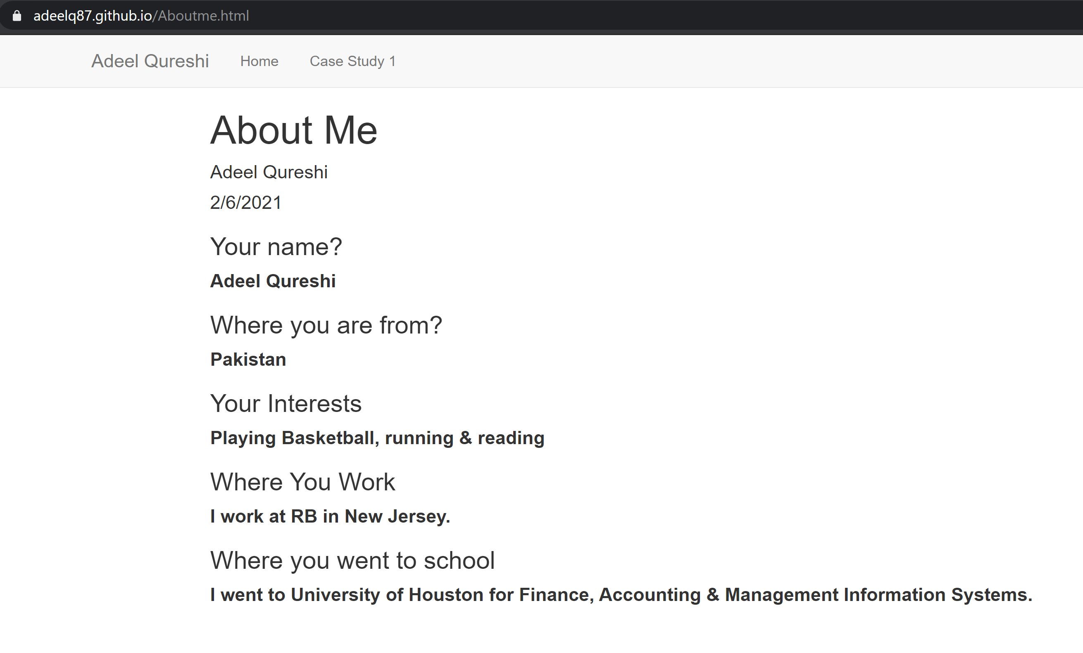

Slide 9
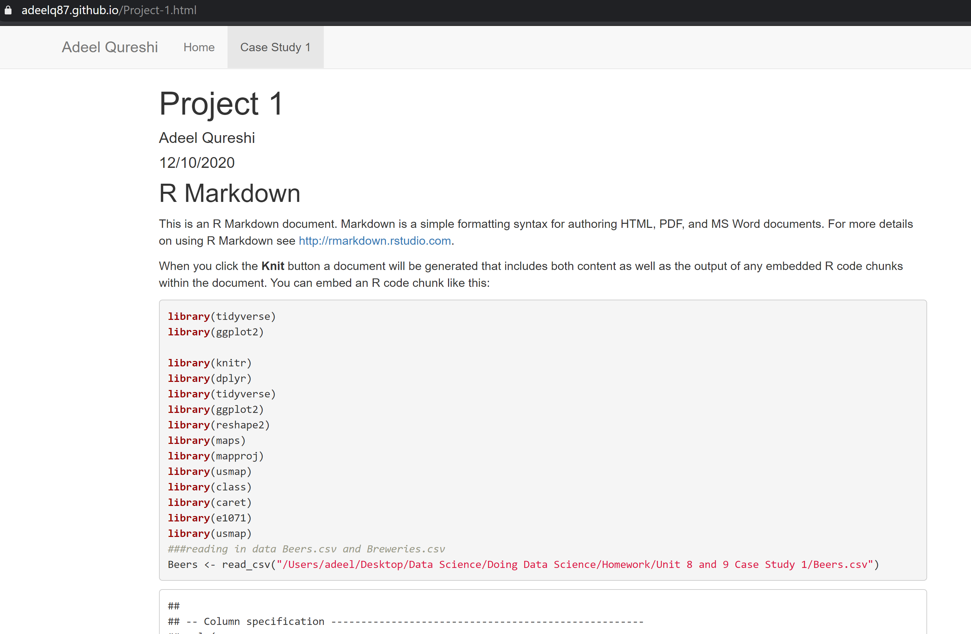

Slide 10
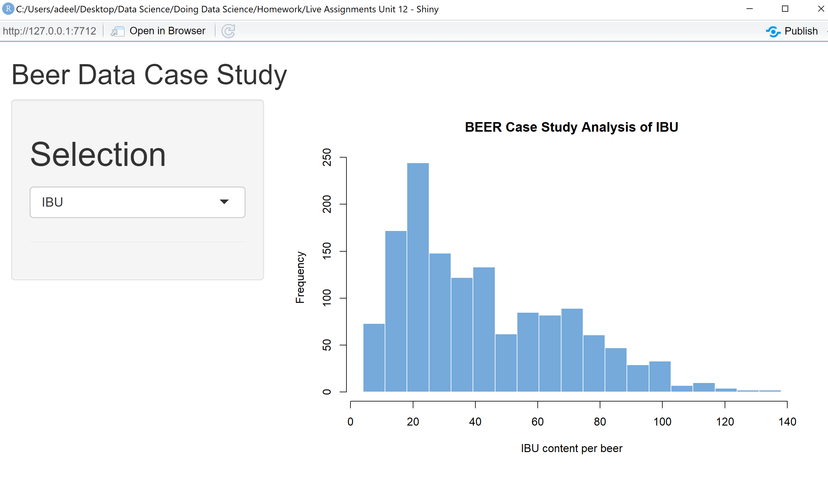

Slide 11
Activity Six: Create an Rshiny App (As long as you want!)
Submit the link to your GitHub Page to the class Google Doc!
Have Fun!!! Go Check out your classmates work!

